Slide 1
Hopping Robot Update VIII
Experiment

Slide 2
Current Objective
Validate/improve simulation with experiments
Conduct experiments on multiple legs to capture:
Forces (load cell)
Jump height (cameras)
Power consumption (V/I sensor)
Angular Position (encoder)
And improve simulation

Slide 3
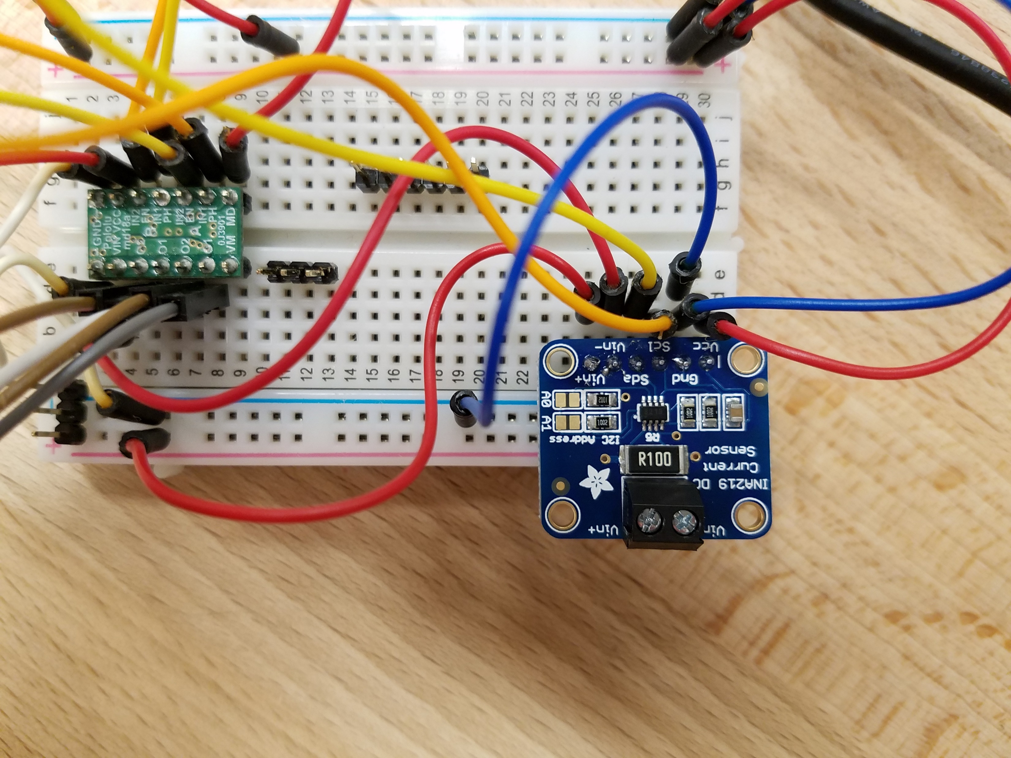
Voltage/Current Sensor
Data collection working

Slide 4
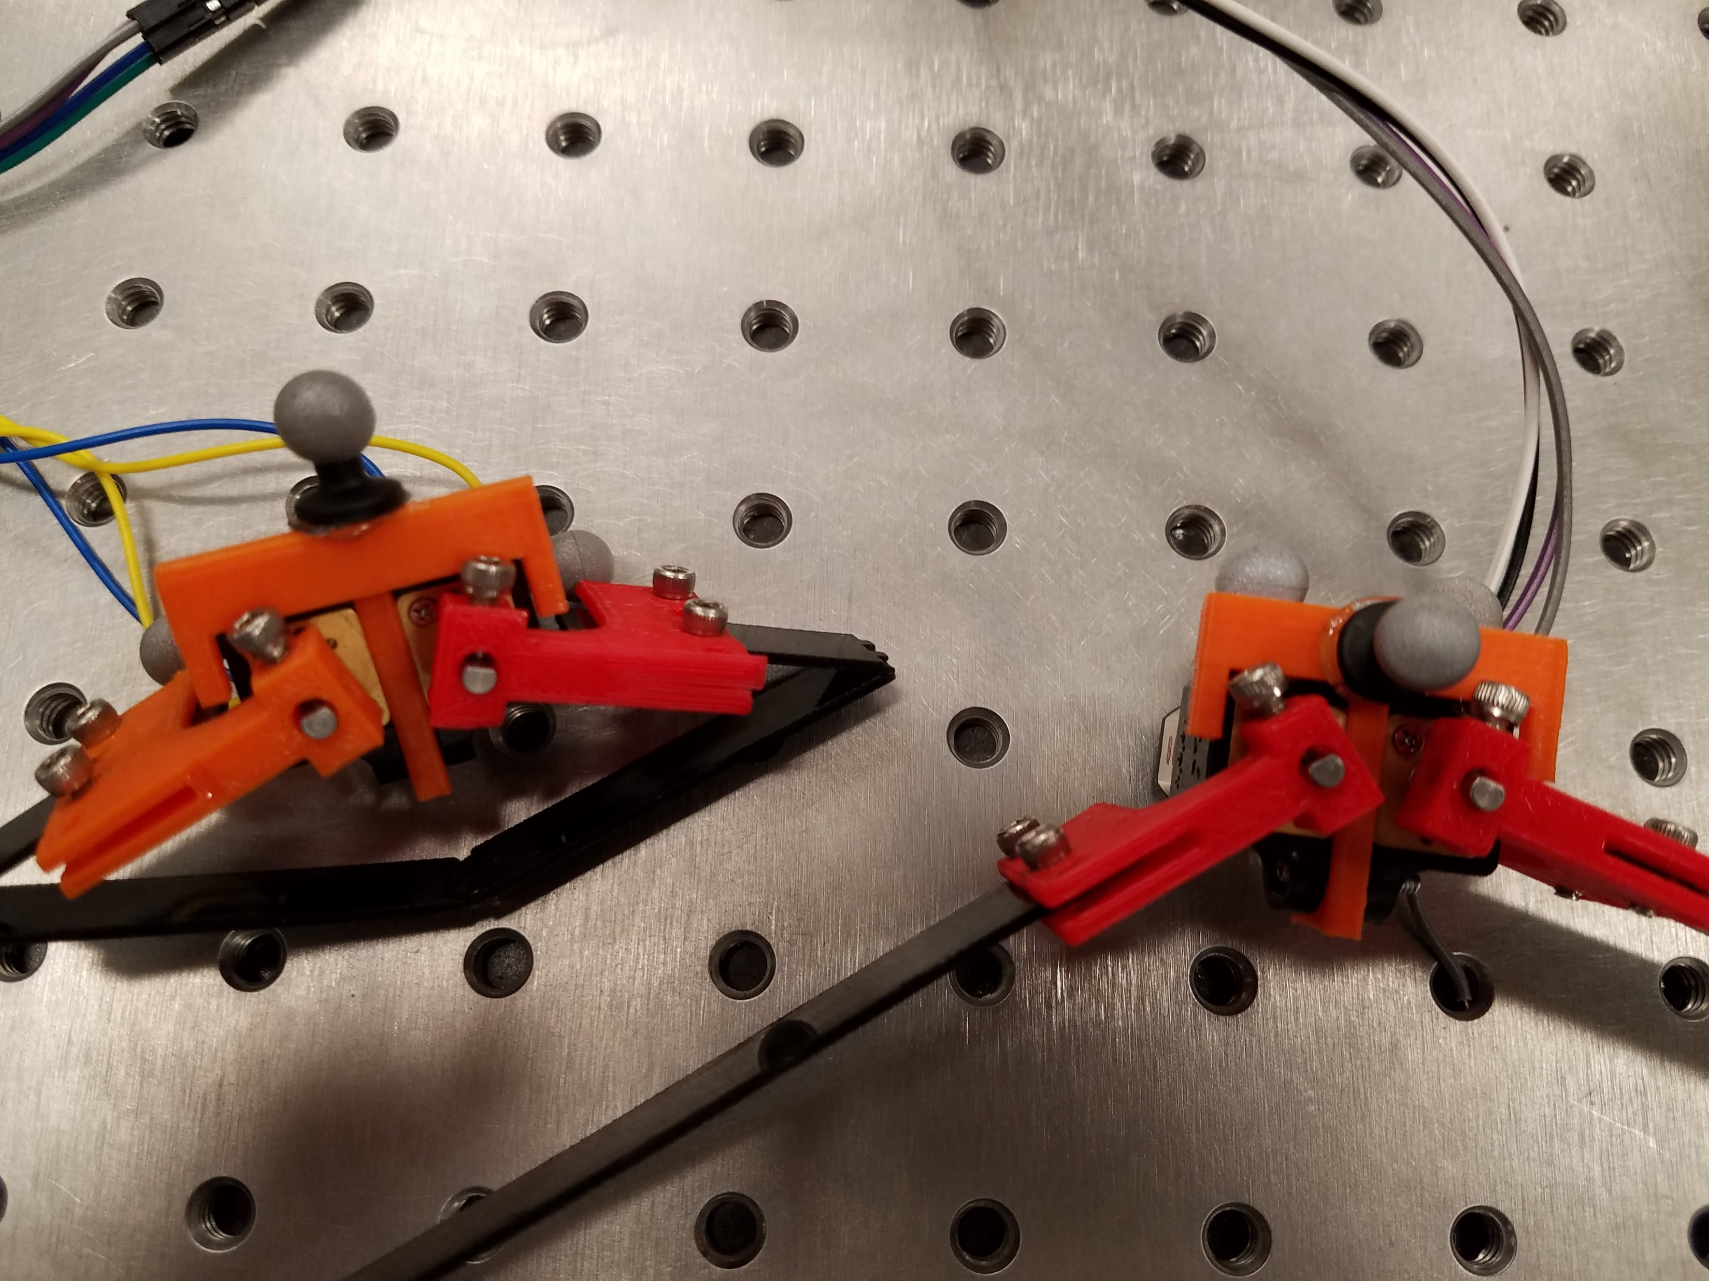
Camera Markers
Add to bottom of leg (flat foot section) to measure height above ground

Slide 5
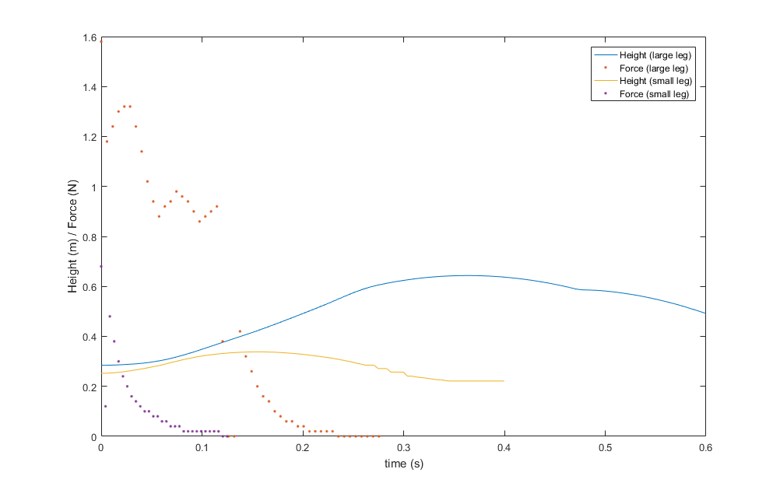
Results

Slide 6
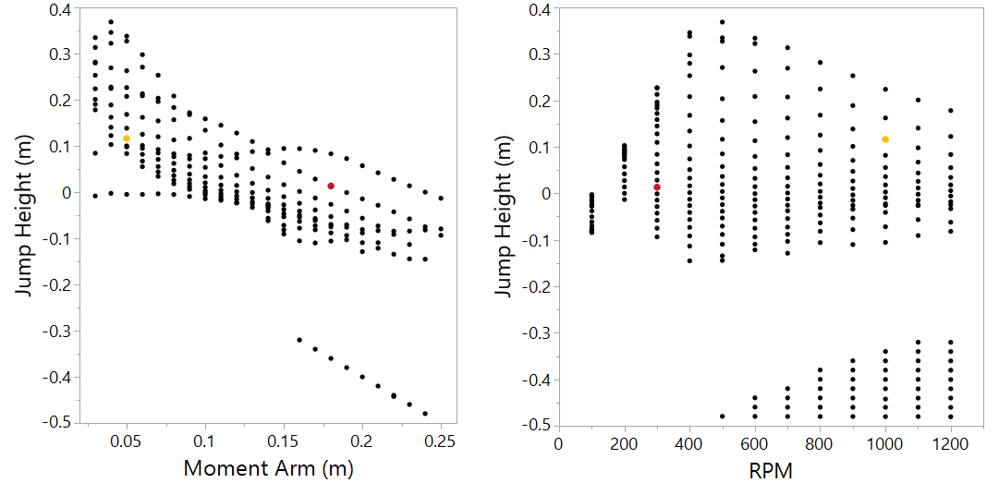
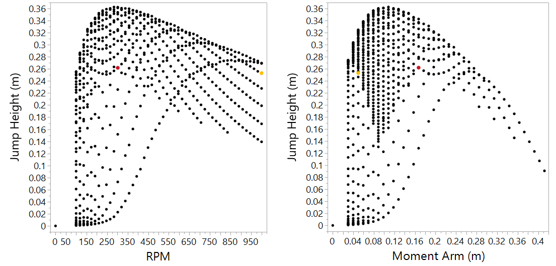
Simulation
Unity Multi-body
MATLAB Single-body

Slide 7
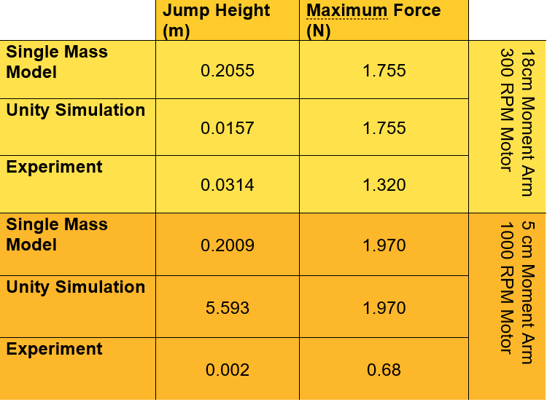
Comparison

